Slide 1
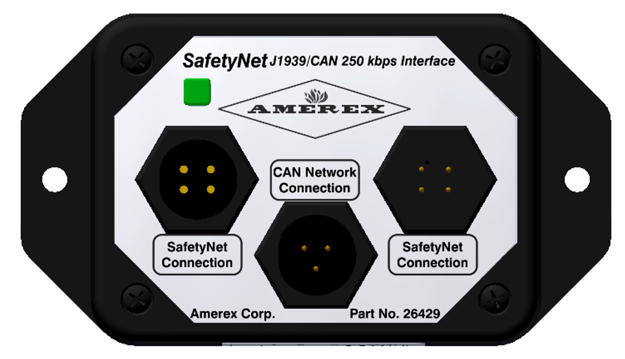
Amerex SafetyNet CAN/J1939 Communications Module Training
Rev. 4.19.20

Slide 2
CAN Module Overview
Product Description
The Amerex SafetyNet CAN/J1939 Communications Module is designed to provide Fault and Alarm notification for SafetyNet Fire Suppression and Gas Detection Systems. The CAN/J1939 module uses the SAE J1939 communications specification
Depending on the specific CAN network operating speed, two modules are available:
Part no. 26429 is designed to operate at 250kbps.
Part no. 26429 is designed to operate at 250kbps.
Both modules are designed with a load resistor and are defined by SAE J1939-11 as Type I ECU’s.
Applications
Part no. 26429 & 27203
The Amerex SafetyNet CAN/J1939 Communications Module is designed to provide Fault and Alarm notification for SafetyNet Fire Suppression and Gas Detection Systems. The CAN/J1939 module uses the SAE J1939 communications specification

Slide 3
Glossary of Terms
TFS Glossary of Terms, Acronyms and Definitions
Updated: 2/25/20
Term or Acronym | Definition Interesting Common Terms
AFSS | Automatic Fire Suppression System
AVM | Automated Vehicle Monitoring
AWL | Amber Warning Lamp - as defined by SAE J1939-71
CAN | Controller Area Network
Combustible Gas Sensor | A type of sensor which detects measurable combustible gases in the atmosphere
DM1 | Diagnostic Message 1 - as defined by SAE J1939-73
DTC | Diagnostic Trouble Code - as defined by SAE J1939-73
ECU type I | An Engine Control Unit which does not contain an internal CAN terminating resistor
ECU type II | An Engine Control Unit which contains an internal CAN terminating resistor
Enumeration | Systematic counting of devices on a network to provide an ordered list
EOL | End of line device which allows for circuit supervision
FMI | Failure Mode Indicator - as defined by SAE J1939-73
J1939 | SAE Recommended Communication Protocol for vehicle CAN networks
Linear Heat Detector | A linear sensor which is normally open and closes at a specific temperature during a fire condition
Optical Flame Detector | A type of sensor which responds to the thermal wavelength of fire
PGN | Parameter Group Number
RS485 | Two Wire Serial Communications Hardware Platform
RSL | Red Stop Lamp - as defined by SAE J1939-71
SA | Source Address - The address of a controller on the J1939 network
SAE | Society of Automotive Engineers
Source Address | Source Address - The address of a controller on the J1939 network
SPN | Suspect Parameter Number
Stub Cable | A CAN/J1939 defined cable connecting the main network to electronic nodes on the network
TFS | Total Fire Systems - SAE Mfg i.d. 541
Thermal Heat Detector | A point sensor which is normally open and closes at a specific temperature during a fire condition
CAN J1939 Module Training.ppt.

Slide 4
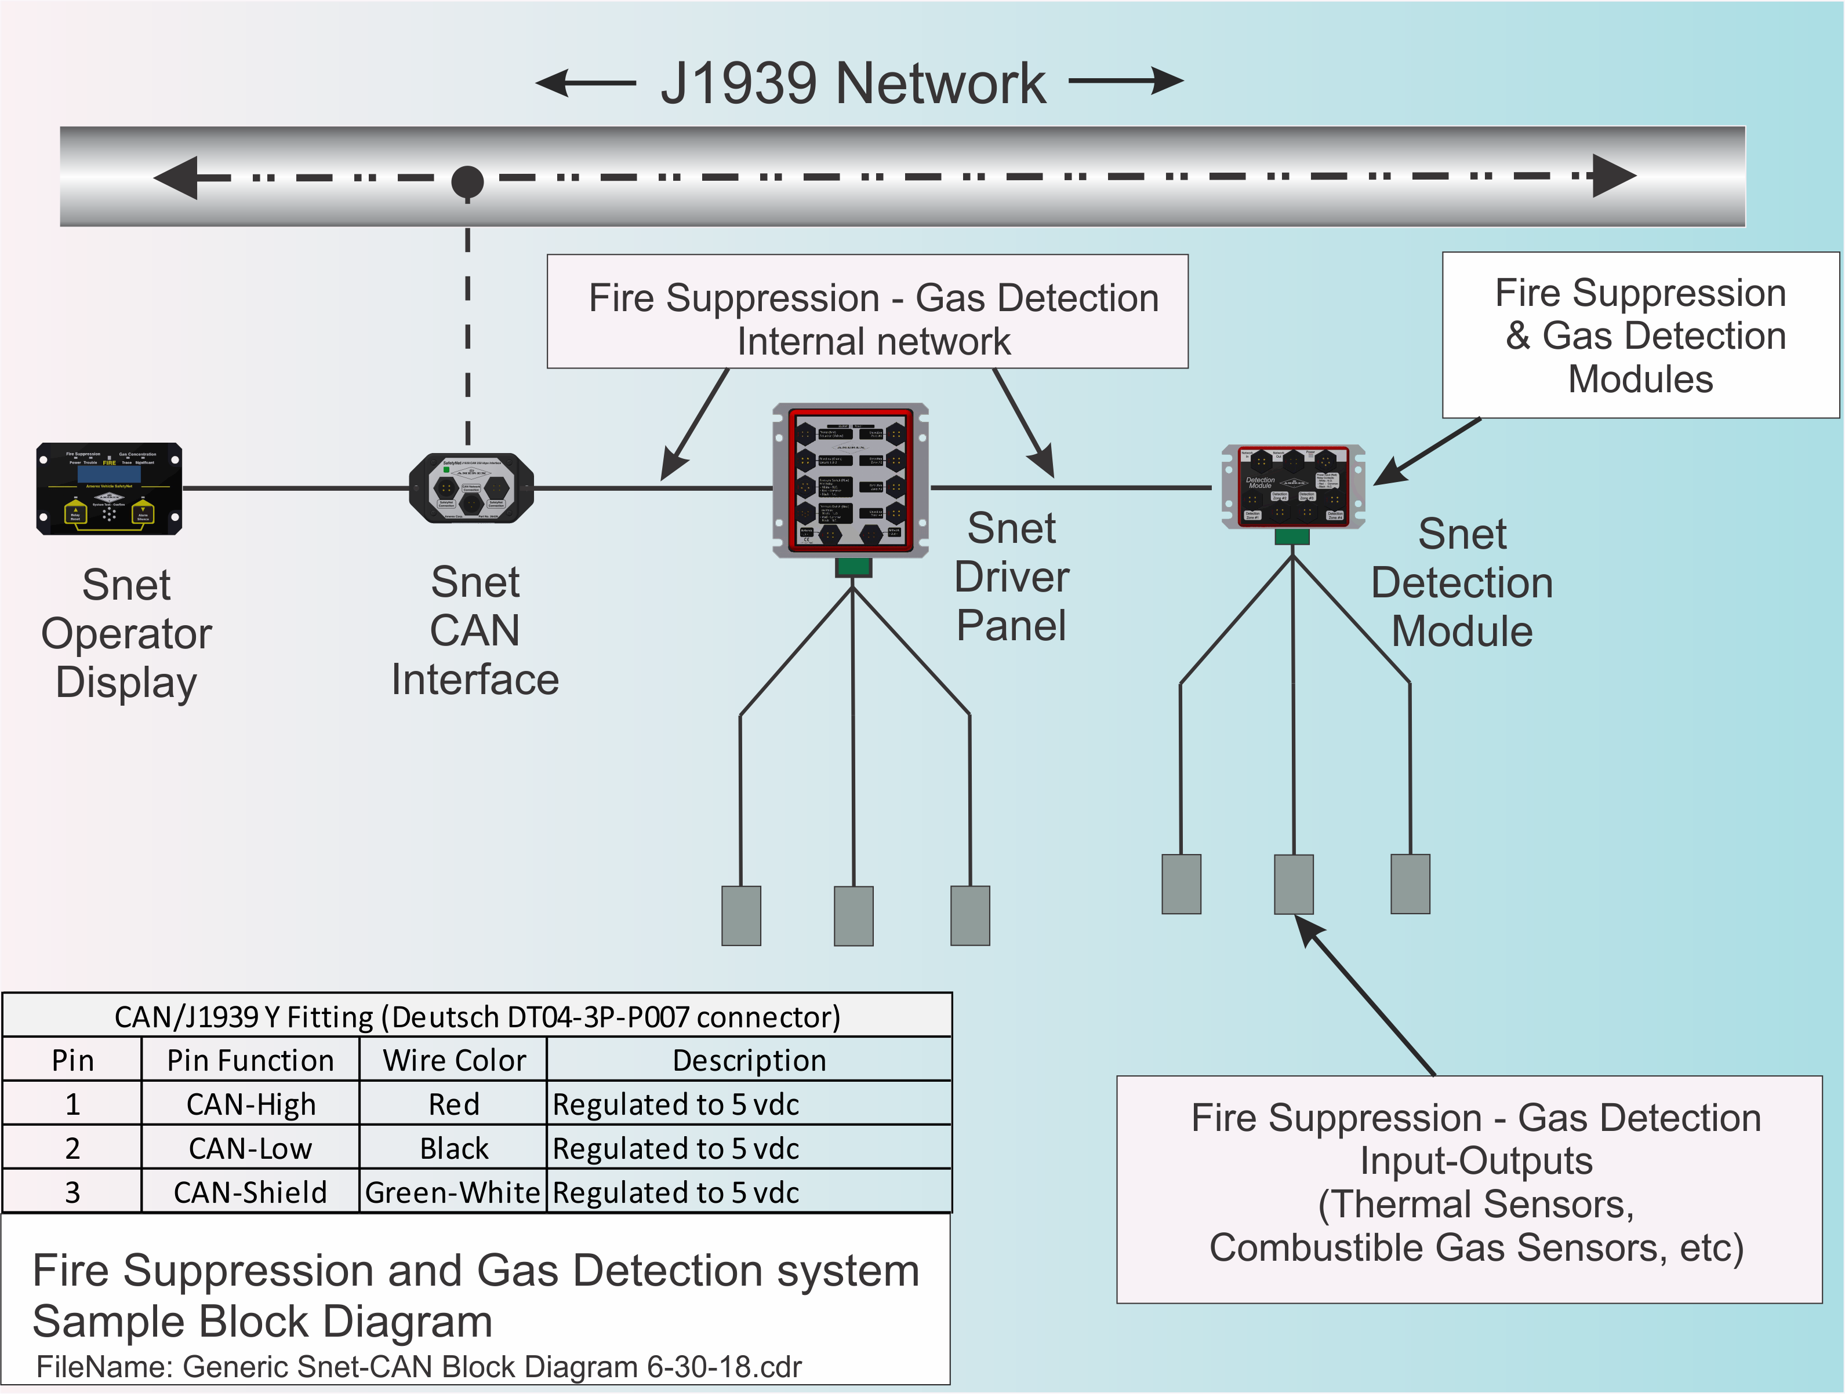
Communication Process Within the SafetyNet System
Communication Between Entities
The SafetyNet system uses an RS485 network to communicate between modules.
A SafetyNet System consists of:
An Operator Display serving as an RS485 serial communications master.
One or more Detection/Releasing modules which serve as RS485 slaves.
The duty of the CAN/J1939 Communications Module is to monitor communications on the SafetyNet network and converts the data into J1939 fault and alarm messages.
SafetyNet messages are then broadcast onto the vehicle’s CAN/J1939 network from Source Address 93 using proprietary SPN’s in the DM1 format. Transmitted messages may be translated in plain English via telematics provider.
Generic SafetyNet System Showing CAN/J1939 Module
Example of translated messages via telematics provider:
CAN J1939 Module Training.ppt.

Slide 5
CAN Module Connections
Part no. 26429 & 27203
SafetyNet Network Connection
SafetyNet Network Connection
CAN/J1939 Network Connection
CAN J1939 Module Training.ppt.

Slide 6
Application & Features
Applications
Transit | Transit | Mining | Forestry | Waste
Public Buses Over the Road Coaches Light Rails | Over the Road Trucks | Ore Haul Trucks Excavators | Feller Bunchers Skidders | Large Compactors Waste Vehicles
Features
Interfaces with all version SafetyNet systems
Provides SafetyNet diagnostic messages to vehicle J1939 network
May be used for system maintenance and safety system diagnostic review
RoHS, Reach & WEEE compliant construction
Two separate part numbers for 250k and 500k baud rate vehicle CAN networks
Connects to vehicle J1939 network and allows for simplified diagnostics and maintenance
Provides SafetyNet diagnostic messages which may be included with all other telematics reports
Translates and transmits SafetyNet proprietary messages to the J1939 network
CAN J1939 Module Training.ppt.

Slide 7
Principle of Operation 1/2
Power Up & Initial Start Up
On power-up, the SafetyNet system will restart and reset several times. At initial start-up, SafetyNet identifies the types and counts the number of SafetyNet Modules on the network. The Operator Display compares this result with stored configuration data.
SafetyNet & Module Configuration Process During Power Up
If the SafetyNet system stored configuration matches the identification routine, SafetyNet begins a continuous polling of the modules. During power-up, the J1939 Communications Module requests a copy of the configuration data from the Operator Display for purposes of detecting any variations in sensor/detector data indicating abnormal operation. This causes the SafetyNet System to reset and repeat the module identification process. Following this reset, the J1939 Communications Module begins monitoring normal communications between the Operator Display and attached Modules. If SafetyNet detects and transmits a Fire or Fault message, the CAN module begins broadcasting the condition as J1939 DM1 message.
Time & Date Request Proceeding Power Up Routine
Also, at start-up, the CAN/J1939 Module requests time and date data from the J1939 System Controller. This synchronizes the SafetyNet System’s real-time clock with the CAN network controller’s clock. When this data is received, it is transmitted by the CAN module to the SafetyNet Operator Display. This causes the SafetyNet System to reset once again. The date and time request may not be fulfilled depending on the telematics provider. This will result in SafetyNet’s original real-time clock being set to its original manufactured time and date.
CAN J1939 Module Training.ppt.

Slide 8
Principle of Operation 2/2
Message Communication
Commercial vehicles have portions but not the entire J1939 message library installed. Each J1939 equipped vehicle can receive generic DM1 messages (PGN). The specific status codes (SPNs) transmitted by the SafetyNet CAN module are found in the table in Section 9.2, along with the plain English and hexadecimal translation. The telematics provider uses this table to present a clear message to the end user by cross-referencing the table with the DM1 message.
Accessing DM1 Codes Online
These SafetyNet DM1 codes are also available as an Excel spreadsheet online at …
https://Totalfirenc.com/aD40Jzx
CAN J1939 Module Training.ppt.

Slide 9
Pre-Installation 1/2
Installation & Start Up Safety
Remove power from the SafetyNet system before making any electrical connections to the CAN Interface Module.
Make sure you understand how the fire suppression system is designed and installed.
The automatic fire system includes pressurized containers which may cause injury if improperly maintained.
The automatic fire system includes devices which contain small amounts of explosives. Take care when handling linear actuators or squib type devices.
Prior to performing any installations or electrical system maintenance:
Unplug and disconnect all Linear Actuators
Replace Linear Actuators with the appropriate Alarm Module
Caution: A fire suppression system discharge may occur if all Linear Actuators are not disconnected before proceeding!
CAN J1939 Module Training.ppt.

Slide 10
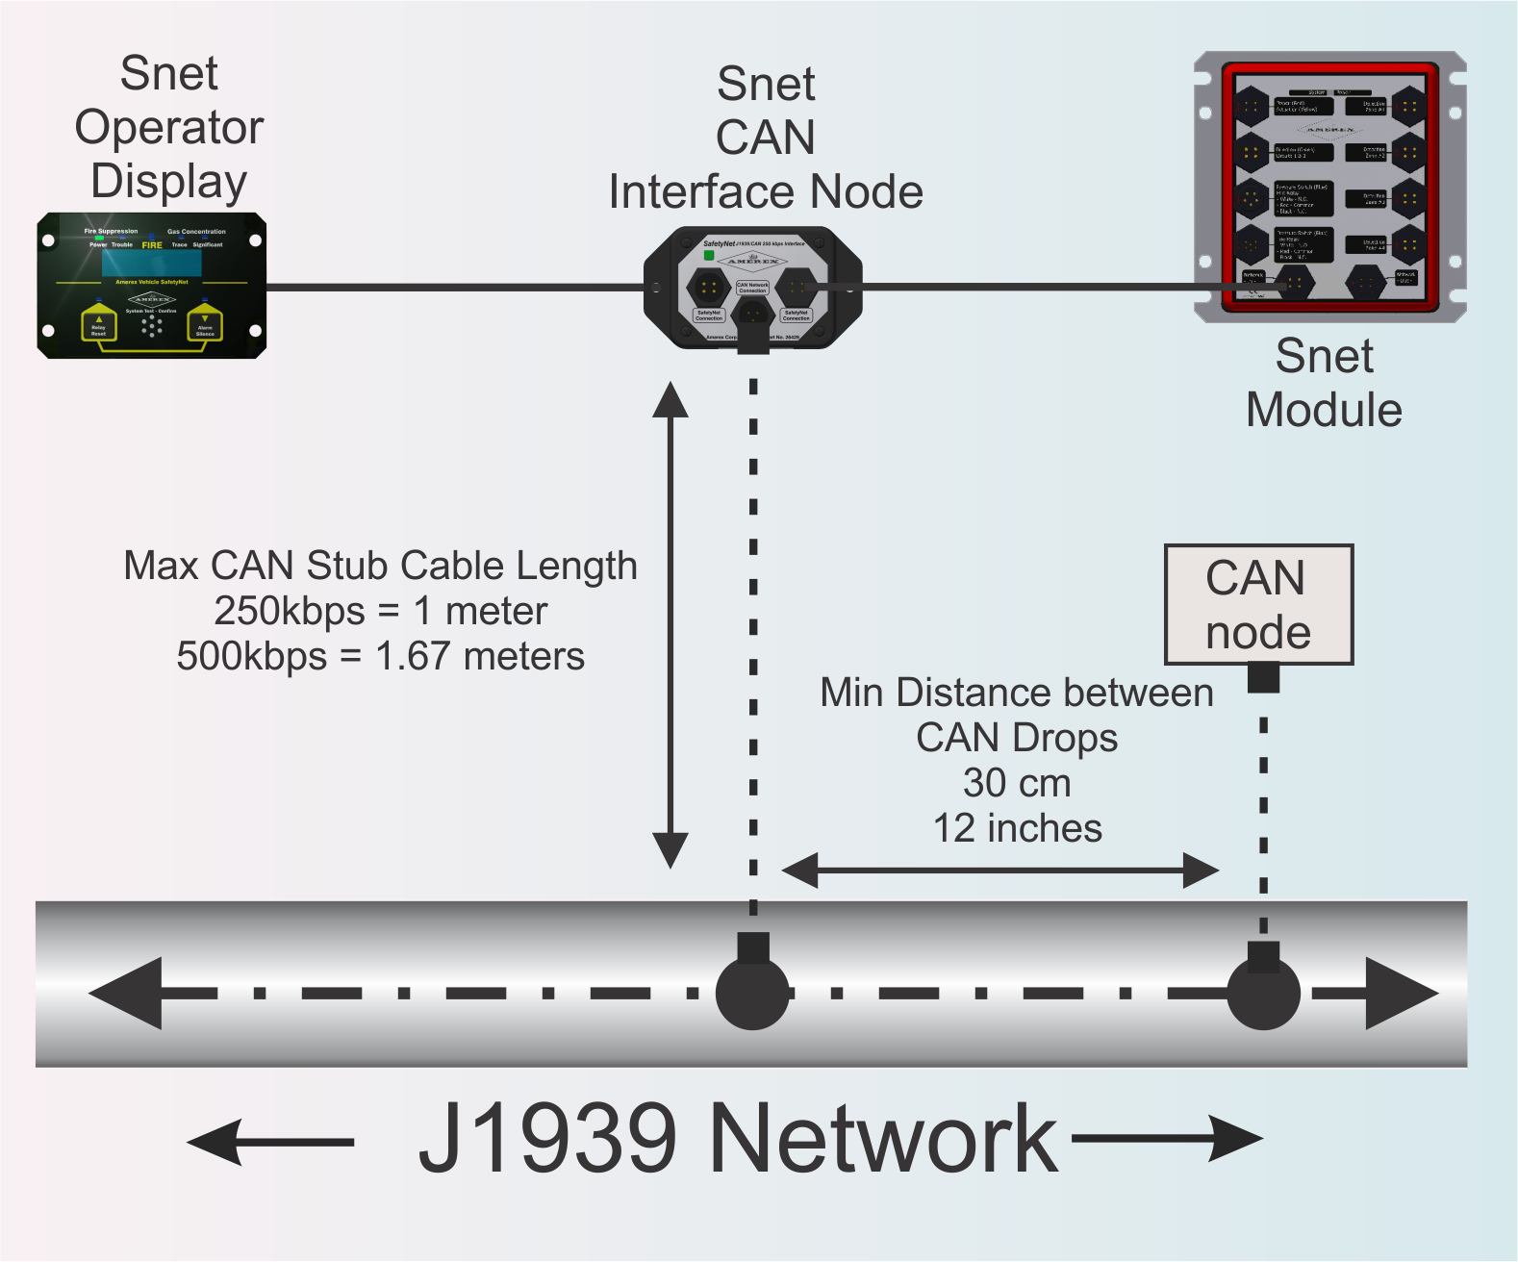
Pre-Installation 2/2
Recommended Tools
Maintenance tools used to access the SafetyNet modules and communication cables
Square drive
Phillips screwdriver
Adjustable wrench
Needle nose pliers
Tie Wraps
Recommended Product Installation Location
A practical location for the Amerex CAN/J1939 Module is near the SafetyNet Operator display and no further than 1 meter from the nearest CAN network drop. Locating the CAN module near the Operator Display allows for a convenient electrical connection and ease of maintenance. The CAN interface module is easily viewed via access panels typically located near the vehicle driver’s seating position.
Field Wiring
Field wiring consists of the addition of a SafetyNet communication cable which completes the cable network running between SafetyNet modules. A separate CAN cable is plugged into the SafetyNet CAN module and connected to a convenient vehicle CAN network access connector.
CAN J1939 Module Training.ppt.

Slide 11
OEM Installation Step 1/3
Step 1: Verify Baud Rate
Verify the baud rate for vehicle CAN network, then verify the proper part number CAN/J1939 module is being installed:
Part no. 26429 250 kbps
Part no. 27203 500 kbps
Step 2: Determine Practical Location for J1939/CAN Module
Ideally the CAN/J1939 module should be located near the Operator Display and as close as possible to convenient CAN network node mating connector. The basic location requirements are as follows:
Maximum CAN 250 kbps network Stub cable length is 1.0 meters or 3.2 feet (CAN network to CAN/J1939 module)
Maximum CAN 500 kbps network Stub cable length is 1.67 meters or 5.4 feet (CAN network to CAN/J1939 module)
Minimum distance between CAN Stub Drops = 30cm or 12 inches
CAN Stub Length – Network drop to CAN Module
CAN J1939 Module Training.ppt.

Slide 12
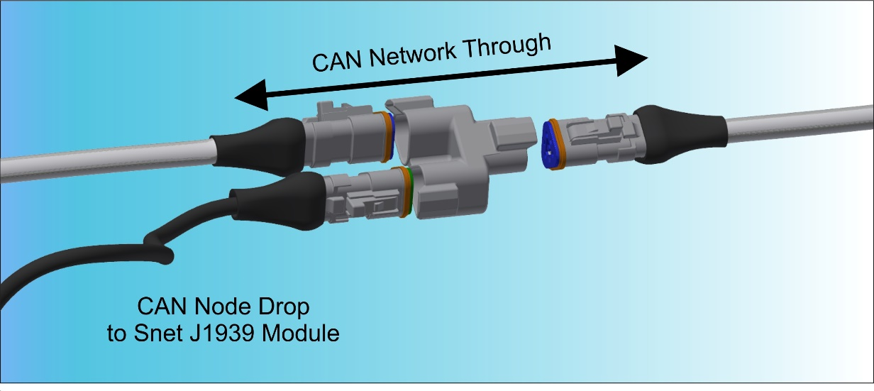
OEM Installation Step 2/3
Step 3: Removing Power & Establishing Connections
Remove power from the vehicle prior to introducing the CAN/J1939 module. Ensure the vehicle is complete OFF. In some cases, a multiplex system will be responsible for commencing “sleep” mode. It may take several minutes for the vehicle to complete power down.
Connect a SafetyNet comm cable to the CAN/J1939 module female socket circular connector and another SafetyNet comm cable to the male pin circular connector of the CAN/J1939 module
Connect the CAN/J1939 cable ends to the network and the opposite 3-position circular connector to the CAN/J1939 module.
Step 4: Identifying Wedgelocks
Typical vehicle CAN networks utilize Deutsch DT style CAN/J1939 connectors. The wedgelocks are color and shape coded indicating their function.
Common colored wedgelocks indicate the CAN thru network wiring. Odd colored wedgelock indicates the CAN network drop.
Rendered View of CAN Network With CAN Module Drop.
CAN J1939 Module Training.ppt.

Slide 13
OEM Installation Step 3/3
Step 4: Identifying Wedgelocks
In the example to the right, the blue wedgelocks connect the CAN network in series while the orange or green wedgelock indicates the network drop to the CAN module.
Step 5: Reviewing & Verifying
Many vehicles may include more than one CAN network i.e. engine CAN and chassis CAN. Make sure you know which CAN network you are connecting to!
After verifying the remaining SafetyNet system components are correctly installed, apply power to the system. After several cycles through the yellow LED, the green LED on the CAN/J1939 module will remain ON once the module is reading SafetyNet data.
Rendered View of CAN Network With CAN Module Drop.
CAN J1939 Module Training.ppt.

Slide 14
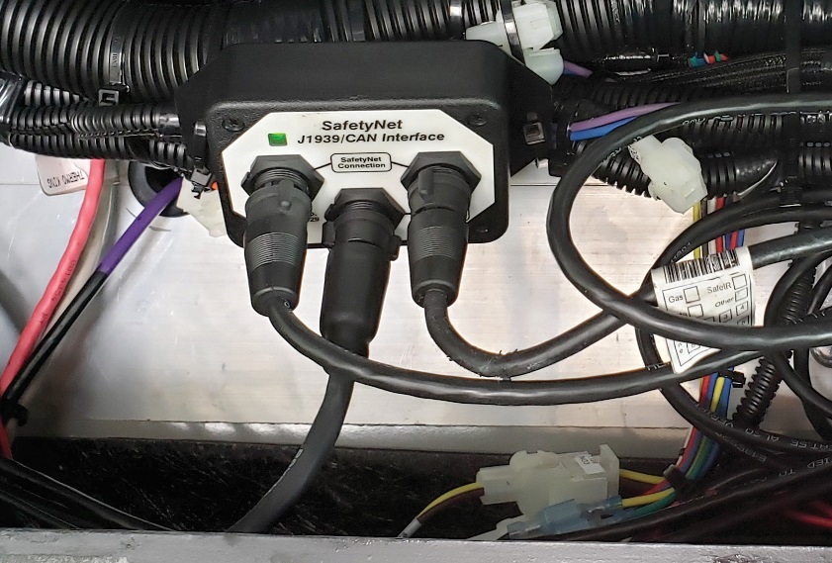
Retrofit Installation Step 1/3
Step 1: Coordinate With The Proper Entities
Discuss the SafetyNet CAN installation in detail with the appropriate authorities. A retrofit installation requires the installer to coordinate between the telematics provider and the end user. Make sure the telematics provider has a copy of the list of diagnostic code located in table 8.3 at the end of this manual. An Excel spread sheet is also available for direct importing.
Check with the appropriate authorities on how best to make the connection to the CAN network. There may be specific CAN network power down/power up requirements prior to introducing a new device
During retrofits, vehicle wiring may not be consistent between vehicles. Multiple CAN networks may be present. It is very easy to make a mistake when trying to verify the correct network to connect to. Check with the local CAN expert to determine proper network connection
CAN/J1939 Module Sample Retrofit Installation
CAN J1939 Module Training.ppt.

Slide 15
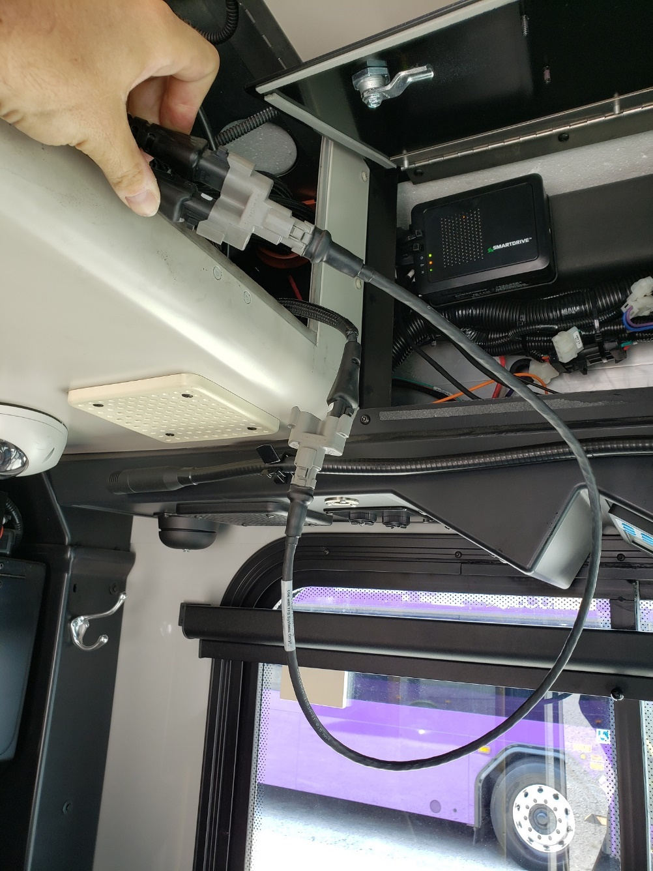
Retrofit Installation Step 2/3
Step 2: Determine Practical Location for J1939/CAN Module
Determine the correct CAN network stub cable interrupt location
Verify the CAN/J1939 module location and CAN stub cable length are correct for the CAN network interface. CAN cable length must be no greater than a maximum of 1 meter (36”) for 250 kbps networks and a maximum of 1.67 meters (62”) for 500 kbps networks. Ensure the CAN interface stub cable is properly shielded and grounded.
Step 3: Establishing Connections
Disconnect the SafetyNet module communications cable from the existing system. Plug the communications cable into the corresponding male or female CAN/J1939 module ports.
Connect a second SafetyNet module communications cable into the second CAN/J1939 module port. Connect the opposite end of the communications cable into the SafetyNet module open port.
Route the CAN stub cable from the CAN module to the vehicle CAN network.
CAN/J1939 Module Sample Retrofit Installation
CAN J1939 Module Training.ppt.

Slide 16
Retrofit Installation Step 3/3
Step 4: End Procedure & Repowering
It is not necessary to reconfigure the SafetyNet system to allow for the J1939 module. The CAN/J1939 module resides passively on the network, reading SafetyNet communications traffic and passing messages up to the vehicle CAN network.
Once repowered, SafetyNet will verify its configuration and reverify a second time as the CAN/J1939 module begins to read data. When the green LED on the CAN/J1939 module is ON, the system is operational.
CAN/J1939 Module Sample Retrofit Installation
CAN J1939 Module Training.ppt.

Slide 17
Maintenance & Testing
General Maintenance & Testing
No maintenance is required.
Functional Testing
No functional testing is required.
Verification of system reporting may be performed periodically and may consist of creating a known Fault condition while the vehicle is not in service. The time and date of the Fault condition should be recorded and later verified for time and date and accuracy of reported event by reviewing the telematics report.
CAN J1939 Module Training.ppt.

Slide 18
Troubleshooting & Customer Support Info
Trouble Shooting References
Troubleshooting Table
Refer to the SAE J1939 documents for CAN network technical information and troubleshooting:
SAEJ1939-11 Dec 2014 Physical Layer, 250 kbps, Twisted Shielded Pair Section 7
SAEJ1939-14 Dec 2014 - Physical Layer, 500 kbps, Twisted Shielded Pair Section 7
Trouble Description | LED indication |  | Recommended Action
 | Snet Display | CAN Module
Snet Operator Display will not clear Trouble | Yellow On | Yellow On | Bypass the CAN module by plugging a Com cable directly into the SafetyNet Operator Display. If the SafetyNet system operates properly, inspect the original cable. Verify all pins are intact on the cable Verify all pins are intact on the CAN module and the Operator Display
Unusual messages appear in the AVM system which appear to be from SafetyNet | Green On | Green On | Verify the CAN wiring to ensure the module is connected to the correct CAN network.
Numbered messages appear in the automatic vehicle monitoring (AVM) system | Green On | Green On | Contact the telematics programmer. Improper coding or coding cross reference is missing
Fault conditions reported | Green On | Green On | A Trouble or Fault condition may have been present but has now cleared. Check the SafetyNet event log or reported trouble location for wiring, sensor or control panel problems particularly if many of the same condition have been reported
Trace gas conditions reported | Green On | Green On | Occasional Trace Gas conditions may be identified by SafetyNet. These may be due to contaminants in the air or occasional low-level accumulation of combustible gas. If many of these events are identified by a single sensor zone, check for gas leaks, damaged sensor or sensor wiring
CAN J1939 Module Training.ppt.

Slide 19
Product Warranty & Appendix
Product Warranty
Seller warrants to Buyer (and to Buyer's customer) that at time of delivery the articles delivered hereunder are free from defects in material and workmanship and conform with the specifications of this order. Seller's sole obligation under this warranty shall be at its option to repair or replace (including payment of shipping charge), or to refund the purchase price of any article or part thereof which proves to be other than as warranted, and/or to repair the defective component; provided that written notice of the alleged defect shall have been given by Buyer, within thirty (30) days after discovery thereof, to Seller prior to the expiration of two (2) years after shipment and/or installation by Seller and further provided that, if Seller so instructs, such article or part thereof is promptly returned to Seller with shipping charges prepaid.
This warranty is the sole warranty of Seller and any other warranties, express, implied in law or implied in fact, are hereby specifically excluded. There are no warranties which extend beyond the description on the face of this purchase order. Seller shall not be liable for collateral, consequential or special damages.
Product Specification Language
A SafetyNet system shall be equipped with a CAN/J1939 Communications Module which transmits AFSS Sensor and System specific event codes (Fire, Sensor Condition, Trouble Condition) to the vehicle CAN network to aid in diagnostics and trouble shooting. Diagnostic resolution is provided to the sensor and zone-specific level. Plain English diagnostic codes are coordinated with the telematics provider either via DM1 or J1939-11 messaging.
CAN J1939 Module Training.ppt.

Slide 20
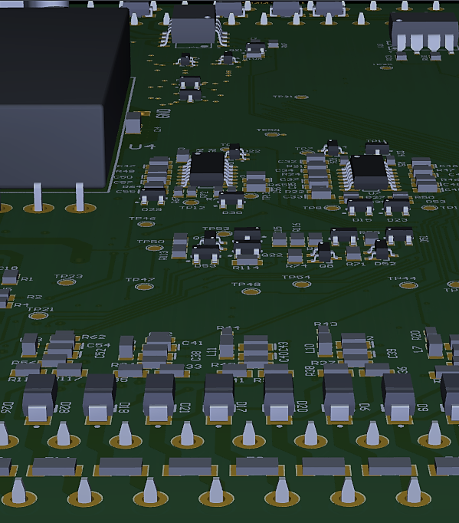
For more information go to www.tfsnc.com
or contact us at …
Total Fire Systems, inc.
P.O. Box 1408
Wake Forest, North Carolina
(919) 556-9161
info@tfsnc.com

